Slide 1

Dosis óptima de proteína en UCI
Daren K. Heyland
Professor of Medicine
Queens University, Kingston General Hospital
Kingston, ON Canada

Slide 2


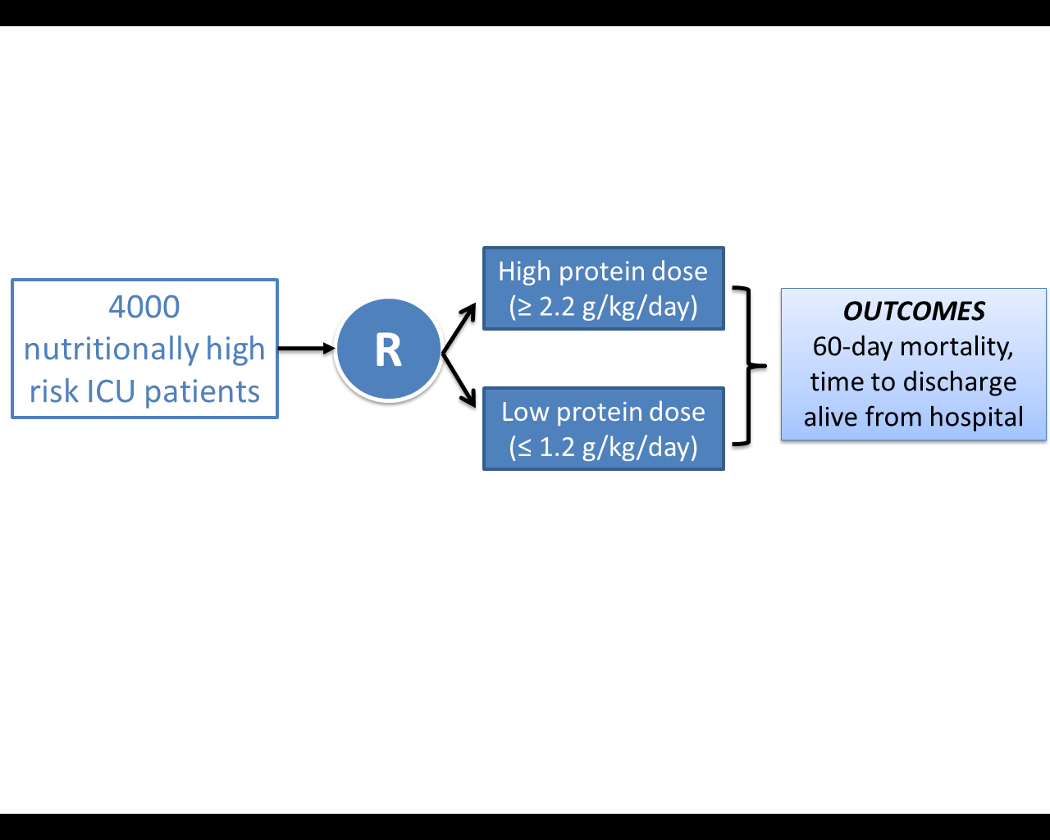
The Effect of Higher Protein Dosing
in Critically Ill Patients:
The EFFORT Trial
Target >2.2 gram/kg/day
Primary Outcome
4000 ICU patients
R
Stratified by:
Site
BMI
Med vs Surg
Fed enterally
60 day
mortality
Target <1.2 gram/kg/day
A multicentre, pragmatic, volunteer-driven, registry-based, randomized, clinical trial.
60 enrolled to date!
Notes:
Will need to update the enrollment
.

Slide 3
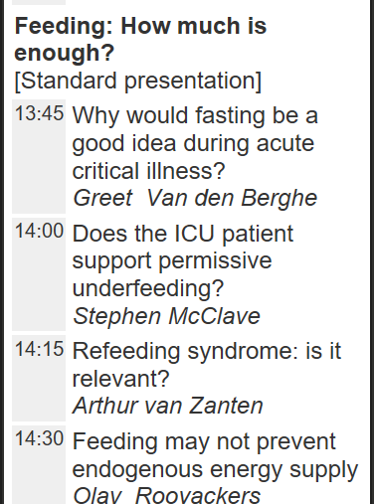

Several Negative Large Scale RCTs in Critical Care Nutrition
EPaNIC NEJM 2011
EDEN JAMA 2012
PERMIT NEJM 2015
NEPHROPROTECT ICM 2015
EAT-ICU ICM 2017

Slide 4
Note: Wide range of acceptability and
Low quality of evidence!

Slide 6
What dose do you routinely prescribe
to the ‘average’ ICU patient?
< 1.0 gram/kg/d
1.1 – 1.5 gram/kg/d
1.6 – 2.0 gram/kg/d
> 2.1 gram/kg/d

Slide 7
Results of 2014 INS
In 2014 INS, on average, patients were prescribed 1.3 grams/kg/day (interquartile range, 1.0-1.5 grams/kg/day,
overall range, 0.5-3.8 grams/kg/day).

Slide 8

Optimal Protein Dose?
Could they benefit from more?

Slide 9
What happens to exogenously administered
amino acid?
Olav Rooyakers CC. icu-metabolism.se

Slide 10
Effect on Nitrogen Balance?
249 trauma patients receiving nutrition support
Dickerson J Trauma Acute Care Surg 2012

Slide 11
What is the evidence that exogenously administered amino acids/protein favorably impacts muscle mass and function?
RCT of 119 ICU patients requiring PN
Randomized to 0.8 gram/kg/day vs. 1.2 grams/kg/day IV aa
Ferrie JPEN 2016

Slide 12
What is the evidence that exogenously administered amino acids/protein favorably impacts muscle mass and function?
No impact on LOS or mortality
Ferrie JPEN 2016

Slide 13
Impact on Clinical Outcomes: RCT Level of Evidence?
The Nephroprotect Study
RCT short-term daily IV aa on kidney function in critical illness, compared to standard care.
Unblinded
All patients expected to remain 48 hrs; excluded patients with AKI
Max protein intake total of 2.0 gm/kg/day (IBW)
More patient in Intervention group with:
  Higher APACHE II severity of illness scores (20.2 ± 6.8 vs. 21.7 ± 7.6, P = 0.02)
  pre-existing renal dysfunction (29/235 vs. 44/239, P = 0.07)
Doig Int Care Med 2015

Slide 14
The Nephroprotect Study
Doig Int Care Med 2015

Slide 15
The Nephroprotect Study
P=0.004
No difference in any other renal or clinical outcome
No impact on survival or HRQOL
Doig Int Care Med 2015

Slide 16
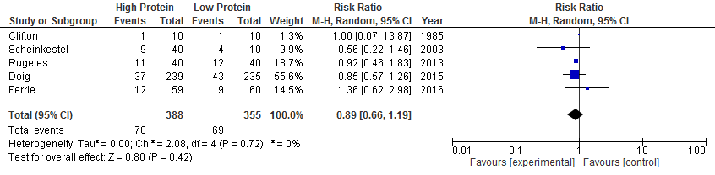
Systematic Review of RCTs of
High vs. Low Dose Protein

Slide 17
What is the evidence that exogenously administered amino acids/protein favorably impacts clinical outcomes?

Slide 18
Impact of Protein Intake on 60-day Mortality
Data from 2828 patients from 2013 International Nutrition Survey
 | Patients in ICU ≥ 4 d
Variable | 60-Day Mortality, Odds Ratio (95% CI)
 |  | Adjusted¹ | Adjusted²
Protein Intake (Delivery > 80% of prescribed vs. < 80%) |  | 0.61 (0.47, 0.818) | 0.66 (0.50, 0.88)
Energy Intake (Delivery > 80% vs. < 80% of Prescribed) |  | 0.71 (0.56, 0.89) | 0.88 (0.70, 1.11)
¹ Adjusted for BMI, Gender, Admission Type, Age, Evaluable Days, APACHE II Score, SOFA Score
² Adjusted for all in model 1 plus for calories and protein
Nicolo JPEN 2015

Slide 19
Rate of Mortality Relative to
Adequacy of Protein and Energy Intake Delivered
Current practice
0.7 gm/kg
Minimally acceptable
1.2 gm/kg
Ideal practice?
>1.5 gm/kg
Heyland JPEN 2015

Slide 20
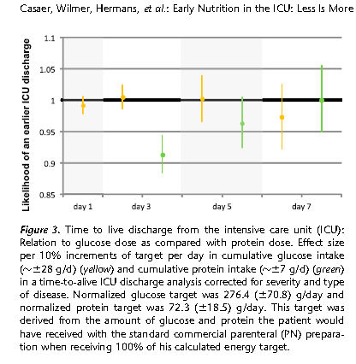
Post-hoc analysis of EPANIC
Indication bias:
1) patients with longer projected stay would have been fed more aggressively; hence more protein/calories is associated with longer lengths of stay.
2) 90% of these patients are elective surgery. There would have been little effort to feed them and they would have categorically different outcomes than the longer stay patients in which their were efforts to feed
3) PN didn’t start till day 3, so all the signal was from small amounts of EN?
Protein is the bad guy!!
Casaer Am J Respir Crit Care Med 2013;187:247–255

Slide 21
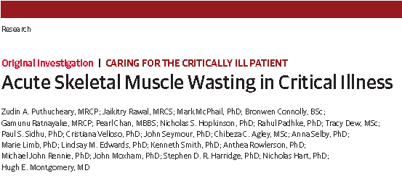
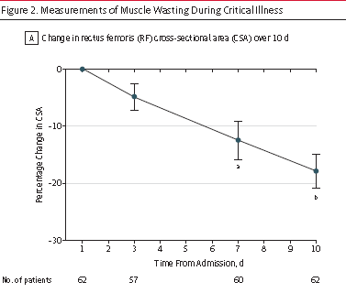
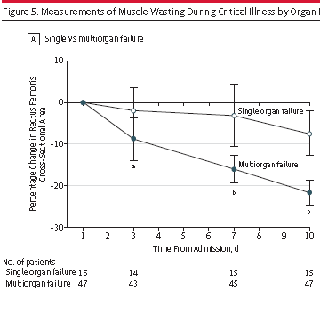
JAMA Published online Oct 9, 2013

Slide 22
“In a multivariable linear analysis, change in rectus femoris CSA was positively associated with the degree of organ failure, CRP level and amount of protein delivered”
JAMA Published online Oct 9, 2013

Slide 23
78 patient with ALI randomized to Intensive Medical therapy (30 kcal/kg/day) or usual care (40-60% of target)
Stopped early because of excess deaths in intensive group
Post hoc analysis suggests increased death from early protein!

Slide 24

RCTs do not suggest any evidence of treatment effect and observational studies suggest increased protein intake associated with…
Reduced mortality¹
Quicker Time-to-discharge-alive¹
Greater preservation of muscle
Reduced infection
Increased mortality²
Slower time-to-discharge-alive from ICU³
Greater loss of muscle mass⁴
2 Braunschweig Am J Clin Nutr 2017
1 Nicolo JPEN 2015
3 Casaer Am J Respir Crit Care Med 2013
4 Puthucheary JAMA 2013

Slide 25
Clinical uncertainty or equipoise exists regarding the best dose for the average critically ill patient!
Totally Agree
Agree
Neutral
Disagree
Totally Disagree
Don’t know

Slide 26
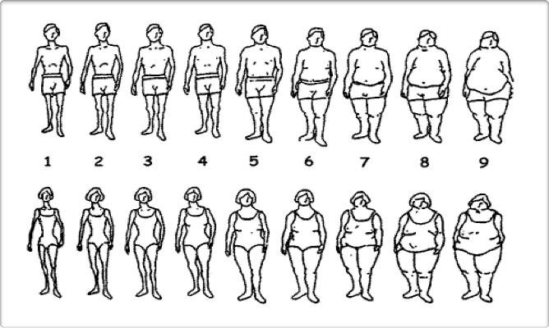
ICU Patients Are Not All Created Equal…
Should We Expect the Impact of Nutrition Therapy to be the Same Across All Patients?
Notes:
Need to study more homogenoous patient populations that are in some way take into consideration of their underlying risk

Slide 27
Overall Hypothesis
Compared to the receiving lower dose of prescribed protein, the prescription of a higher dose of protein/amino acids to nutritionally high-risk critically ill patients will be associated with greater amount of protein delivered and result in improved survival and a quicker rate of recovery.

Slide 29
The Effect of Higher Protein Dosing
in Critically Ill Patients:
The EFFORT Trial
Target >2.2 gram/kg/day
Primary Outcome
4000 ICU patients
R
Stratified by:
Site
BMI
Med vs Surg
Fed enterally
60 day
mortality
Target <1.2 gram/kg/day
A multicentre, pragmatic, volunteer-driven, registry-based, randomized, clinical trial.
Notes:
Stop here for questions
.

Slide 30

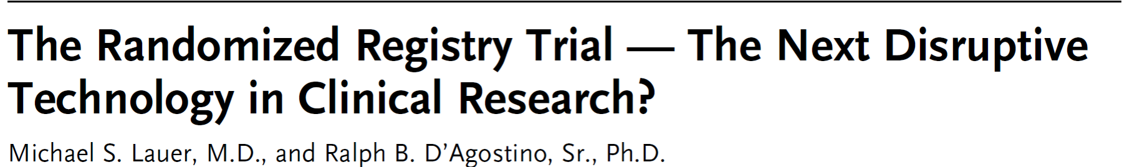
Clinical registries are established tools for auditing clinical standards and benchmarking QI initiatives
Data from clinical registries can be used to formulate hypothesis
With appropriate methods, make causal inferences (albeit weaker inference)
Results more generalizable
NEJM 369;17:1579

Slide 31
Randomized patients undergoing angioplasty to manual thrombus aspiration or usual care.
Used existing national cardiac registries
Over 7000 patients were efficiently recruited from the registry to evaluate the study question and aside from the randomized intervention, the trial imposed no other study procedures and all data were collected by existing registries supported by funds from national or other hospital sources.
Total incremental cost 300,000 Euros; 50 Euros/patient enrolled!
Am Heart J 2010:160:1042 and NEJM 2013;369:1587

Slide 32
Registry-based Randomized Clinical Trials (RRCT)
A possible solution?
Recent experience with large scale, multi-center, observational studies conducted by volunteers in hundreds of ICUs around the world opens the possibility of using the same International Nutrition Survey (INS) infrastructure to support large scale, randomized trials.
The creation of registry-based, volunteer supported, large-scale, randomized clinical trials related to critical care clinical nutrition

Slide 33


Participation Across the 5 Years of the Survey : 708 Distinct ICUs
Canada: 95
USA: 225
Europe and Africa: 109
UK: 37
Turkey: 11
Ireland: 12
Italy: 9
Norway: 8
South Africa: 13
Switzerland: 4
Spain: 4
Slovenia:1
Sweden: 3
Czech Republic:3
Austria:2
Portugal:1
France:1
Asia: 145
Colombia:19
Brazil:10
Argentina:7
Uruguay:5
Mexico: 3
Chile:3
Venezuela:2
Peru:1
Paraguay:1
El Salvador:1
Puerto Rico:1
China: 38
Japan: 43
India: 36
Taiwan:5
Singapore: 11
Saudi Arabia:2
Philippines:2
Iran : 2
Thailand: 2
UAE:1
Malaysia:2
Indonesia:1
Latin America: 53
Australia: 73 New Zealand: 8

Slide 34
Value of Bench-marked Site Reports
Recommendations: Based on 8 level 2 studies, we recommend early enteral nutrition (within 24-48 hrs following resuscitation) in critically ill patients.
Early vs Delayed Nutrition Intake

Slide 35
Intervention
Eligible patients will be randomized to one of 2 groups:
  High dose group: Patients will be prescribed >2.2 g/kg/day
  Low dose group: Patients will be prescribed <1.2 g/kg/day
BOTH groups
  Use dry pre-ICU body weight
  Use IBW based on a BMI of 25, if BMI >30
  Achieve goals through any combination of enteral and parental sources (as needed).
  The only difference between the 2 groups are the protein targets that are set.
  Success defined as achieving at least 80% of protein targets

Slide 36
Is there enough uncertainty that practitioners will be comfortable with their patients being randomized to ‘low dose’ group? to the high group? if not, don’t enroll!
What is the effect of prescribing a higher dose (>2.2 grams/kg/day) of protein/amino acid administration compared to a low group prescribed <1.2 gram/kg/day on 60 day mortality?

Slide 38
Protein intake is most important in patients with high nutritional risk. What tools to evaluate nutritional risk have been validated in critically ill patients?
Subjective Global Assessment
NRS-2002
NUTRIC Score
None of the above

Slide 39
Study Population
Inclusion Criteria | Exclusion Criteria | Rationale for Exclusion
1. >18 years old 2. Nutritionally “high-risk” (meeting one of the below criteria) Low (<25) or High BMI (>35) Moderate to severe malnutrition (as defined by local assessments) Frailty (Clinical Frailty Scale, 5 or more from proxy) Sarcopenia – (SARC-F score of 4 or more from proxy) From point of screening, projected duration of mechanical ventilation >4 days) 3. Requiring mechanical ventilation with actual or expected total duration of mechanical ventilation >48 hours | >96 continuous hours of mechanical ventilation before screening | Intervention is likely most effective when delivered early
 | 2. Expected death or withdrawal of life-sustaining treatments within 7 days from screening | Patients unlikely to receive benefit
 | 3. Pregnant | Unknown effects on fetus
 | 4. The responsible clinician feels that the patient either needs low or high protein | Uncertainty doesn’t exist; patient safety issues
 | 5. Patient requires parenteral nutrition only and site does not have products to reach the high protein dose group. | Site will be unable to reach high protein dose prescription.

Slide 40
Subgroup Analyses
Age (based on median)
Severity of illness (based on median APACHE II)
Case Mix
  Sepsis
  Burns
  Trauma
  AKI and/or RRT at baseline
Malnutrition risk factors, both individually and combinations
Wounds
Others?

Slide 41
Data Collection
(Similar to INS in the past only less data)
Patient demographics
  Age, Sex, comorbidities
  Admission type and diagnosis
  APACHE II, SOFA
Nutritional Assessment
  Weight, height
  Malnutrition, frailty, SARC-F
  Goals
Nutrition Processes of Care
  Timing and use of EN, PN, supplements, propofol (not IV glucose)
  Adequacy of protein and energy
Labs
Glucose, renal function, phosphate

Slide 42
Outcomes
Limited outcomes collected in INS
  Nutritional adequacy
  Persistent Organ Dysfunction PODS)
    Use of vasopressors, RRT, ventilation
  Duration of mechanical ventilation
  Duration of ICU and Hospital stay
  Hospital mortality
  60-day mortality
  Readmissions to ICU and Hospital within 60 days of enrollment
  Discharge status
  Time to discharge alive from hospital
Addition of performance-based measures via sub-studies?
  Hand grip strength? 6 MWD? 4ms?
  Questionnaires asking ADLs/QOL at 3 and/or 6 months?

Slide 43
Statistical Considerations
Large pragmatic trial with little effort to restrict participation of sites and patients nor standardize co-interventions will increase noise
Aim to have power to detect smaller treatment effects which will increase sample size requirements
Need 4000 patients!
Final analysis will be intention-to-treat

Slide 44
Ethical Issues
Obtaining informed consent will also be a barrier.
Waiver of informed consent possible? (Yes, for 2 sites in the USA so far)
Minimal Risk?
  Has been so far for INS (de-identifiable data)
  Addition of randomization factor for usual care interventions does not change the risk and require informed consent (IMHO)
Impractical?
  Without funding, would be impractical to use research resources to consent families (we are relying on clinicians volunteering on their own time to recruit eligible patients).
Plan to work with some sites to ‘test the waters’ to see if we can get a waiver and just provide information letter to families/SDM
If not, have ICF ready to go but puts extra burden on the site.

Slide 45
Setting
ICUs from around the world will voluntarily participate and be screened for suitability.
What will be our criteria for suitability?
  Participants must be knowledgeable about critical care nutrition (submit their CV or other documentation);
  Have Good Clinical Practice (or similar) training (submit their training certificate);
  Confirm their site has overall equipoise and is willing to abide by the randomization schema and not overfeed patients;
  Confirm they use some form of a standardized feeding protocol (specific nature of the protocol not important);
  Confirm they have access to a range of commercial products (high protein enteral nutrition, protein supplements, and parenteral nutrition or amino acids);
  Have obtained ethics approval.
  Provide an electronic signature that they will be committed to enrolling a minimum of 30 eligible patients in 2-3 years.

Slide 46
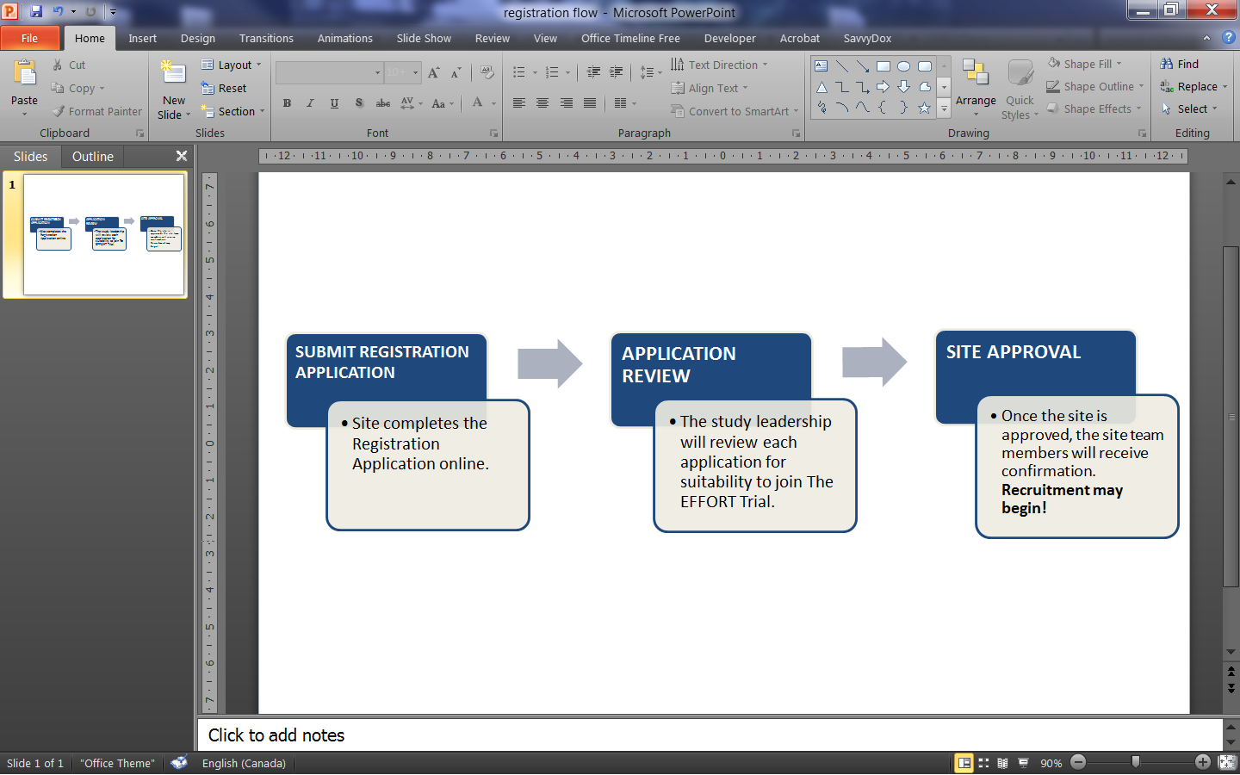
Site Registration Process

Slide 47
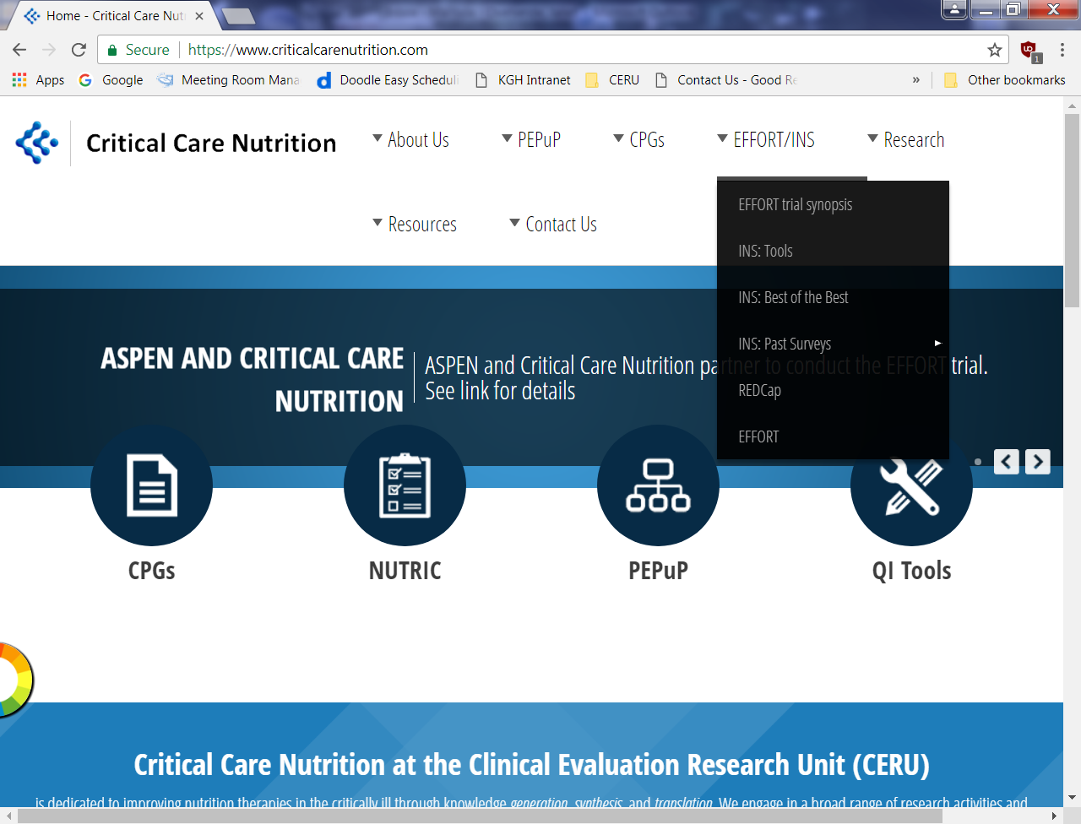

Slide 48

Come to EFFORT trial meeting Tuesday, 12:45-2:15
Room Auditorium
For more information
See www.criticalcarenutrition.com or contact: Daren Heyland dkh2@queensu.ca
Notes:
Alfonso, find out the room and add to this slide

Slide 49
I see no reason to change practice at the moment…
…but we need more data! Join the EFFORT!

